Slide 1
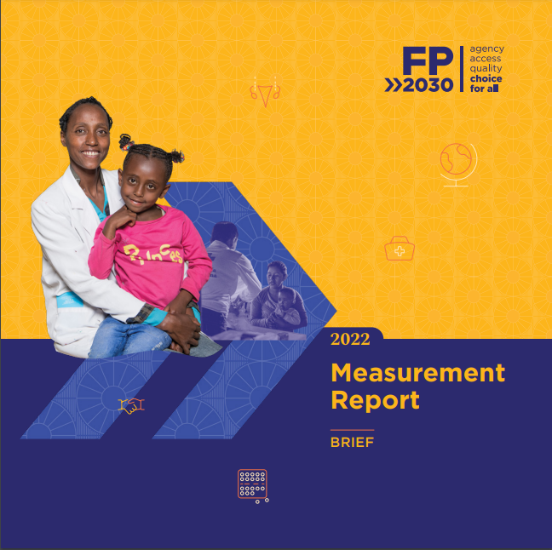
FP2030 Measurement Report 2022
2021-2022
1/26/2023
Family Planning 2030

Slide 2
FP2030 Measurement Report 2022 Graphics
Measurement Report 2022
The following graphics are from the FP2030 Measurement Report 2022. They are sized for easy copy and pasting into your presentations.
We encourage their use, but request that the graphics be cited as follows:
FP2030 Measurement Report 2022
Please see the notes section of the slides for additional information and footnotes pertaining to the graphics.

Slide 3
Measurement Framework

Slide 4
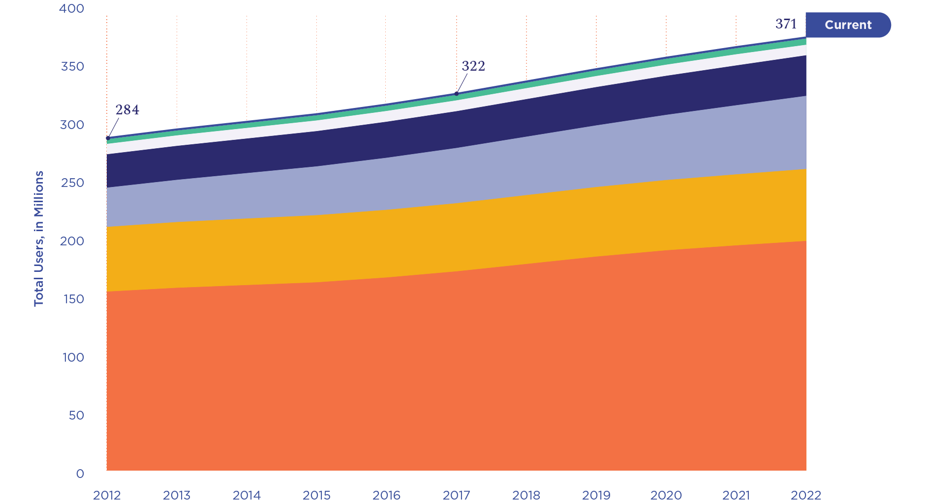
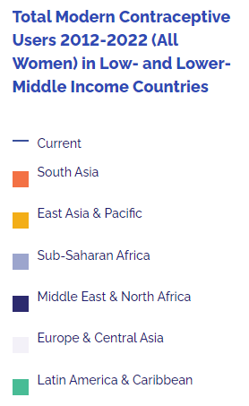
Measurement Framework

Slide 5
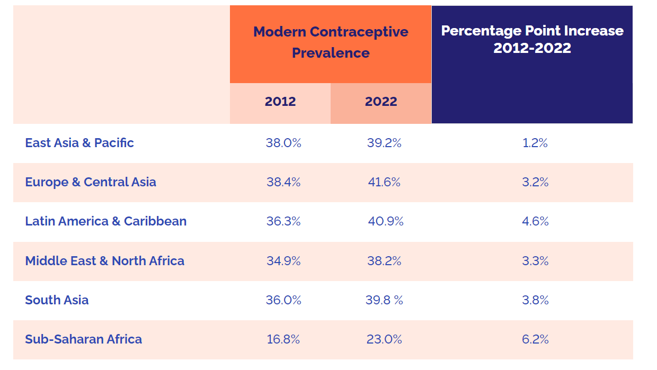
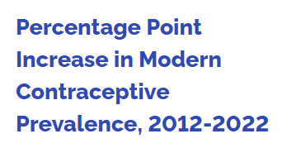
Measurement Framework

Slide 6
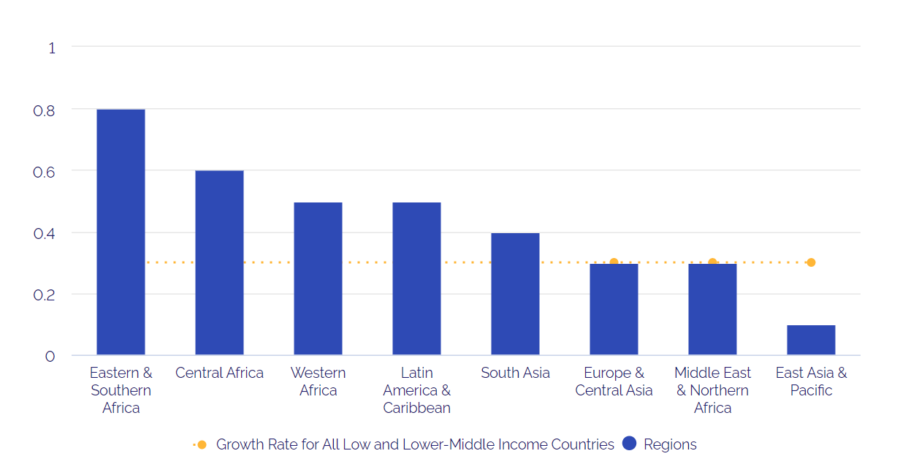
Measurement Framework

Slide 7
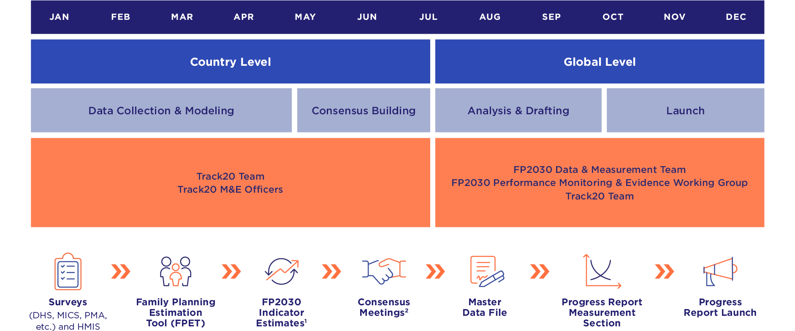
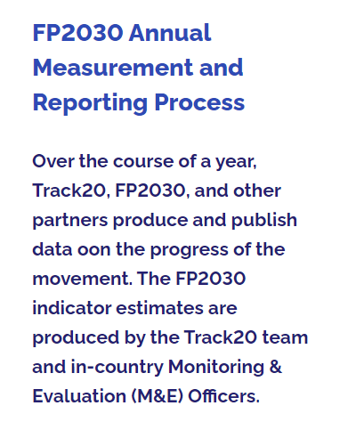
Measurement Framework

Slide 9
Regional Profiles

Slide 10
Adolescents and Youth

Slide 11
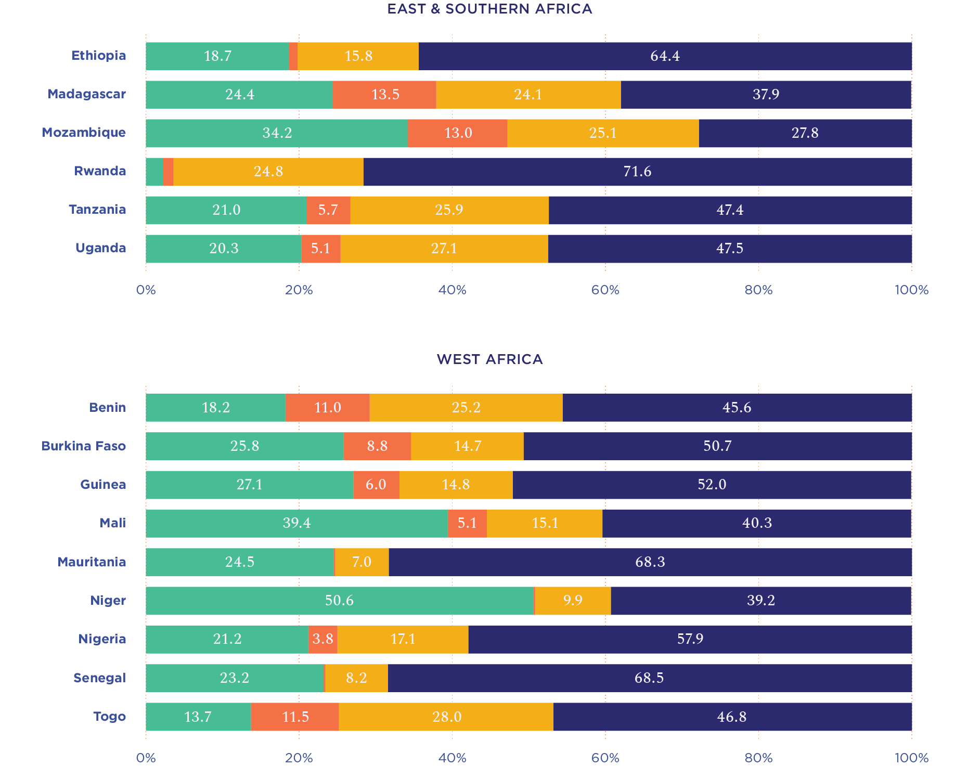
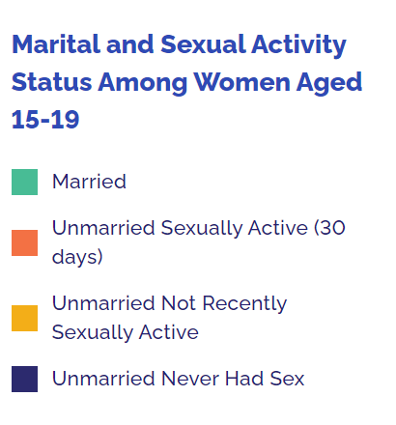

Slide 12
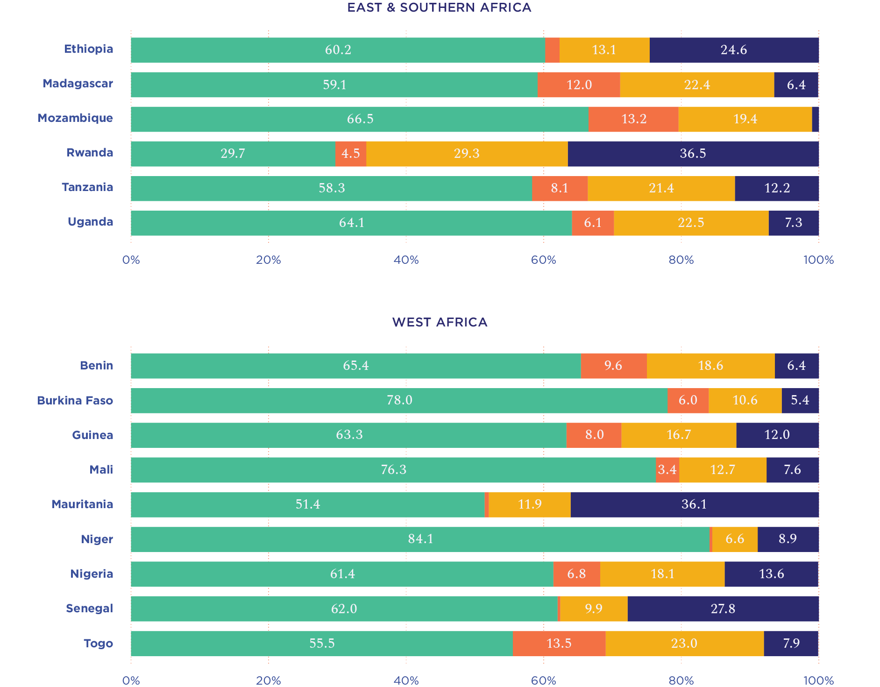
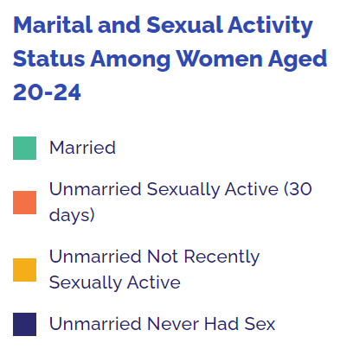

Slide 13
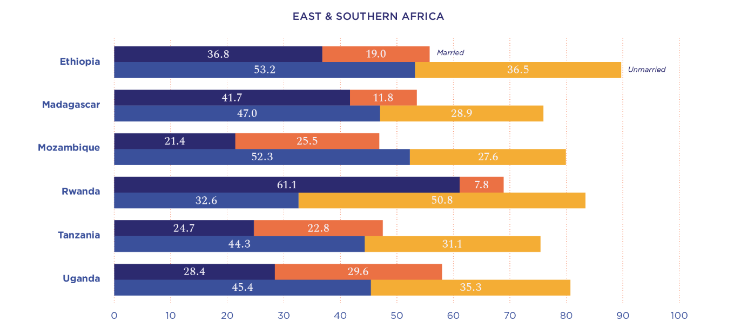
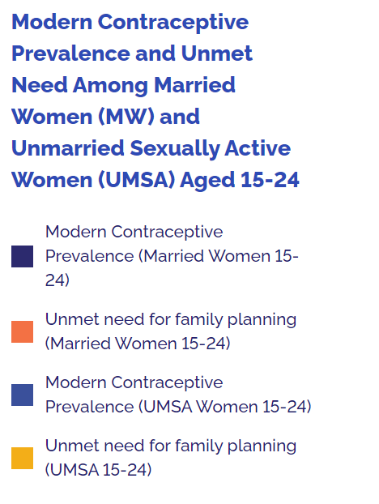
Regional Profiles: Sub Saharan Africa
Notes:
Now we will review modern contraceptive use and unmet need. For this slide and next – we have combined 15-19 and 20-24.
One this slide, you’ll see MCP and unmet need for MW and UMSA 15-24. The blue bars are MCP and brown bars are Unmet Need. Dark Blue for UMSA; Light blue for MW. Dark brown for UMSA and light brown for MW.
Contraceptive use among married and unmarried sexually active women aged 15-24 is generally higher in East & Southern Africa than in West Africa.
The regional difference in modern contraceptive use is especially high among young married women. Modern contraceptive use among married women aged 15-24 in East and Southern Africa is typically higher and ranges from 21.4% in Mozambique to 61.1% in Rwanda; in West Africa it is typically lower and ranges from 6.4% in Nigeria to 30.2% in Burkina Faso.
Among young married women, in 9 countries, more than 1 in 5 married have an unmet need– 6 countries out of 9 are in WA.
Now reviewing UMSA, in both regions, UMSA MCP is higher than married women MCP. However, unmet need is also higher.
In 11 countries, more than 1 in 5 UMSA women have unmet need – 6 countries are in ESA and 5 are in WA.
Unmet need for unmarried sexually active women aged 15-19 is also especially high in West Africa. In three countries (Benin, Mali, Nigeria, over 50% of unmarried sexually active women aged 15-24 have an unmet need for family planning.

Slide 14
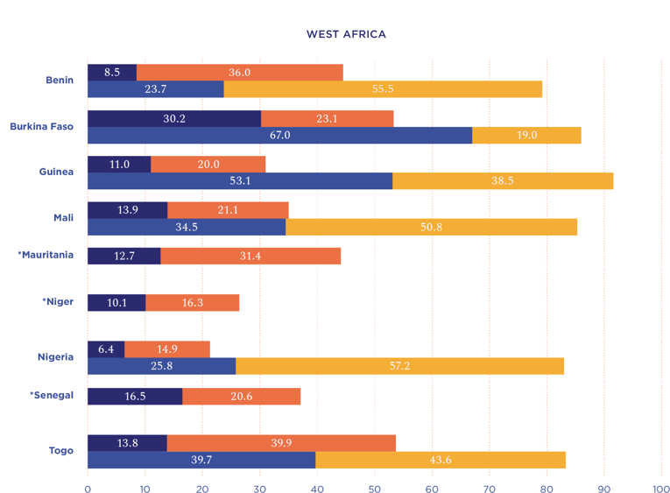
Regional Profiles: Sub Saharan Africa

Slide 15
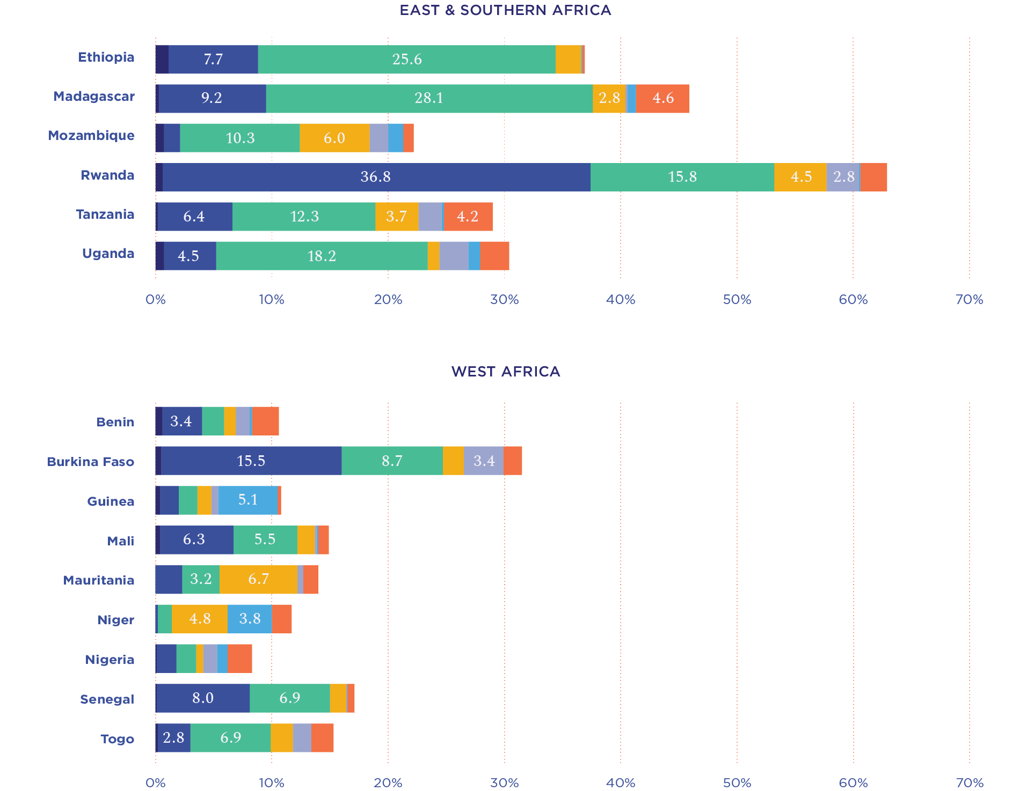
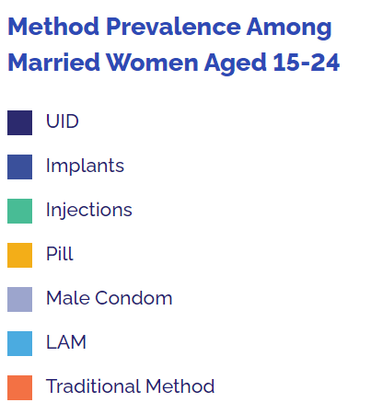

Slide 16
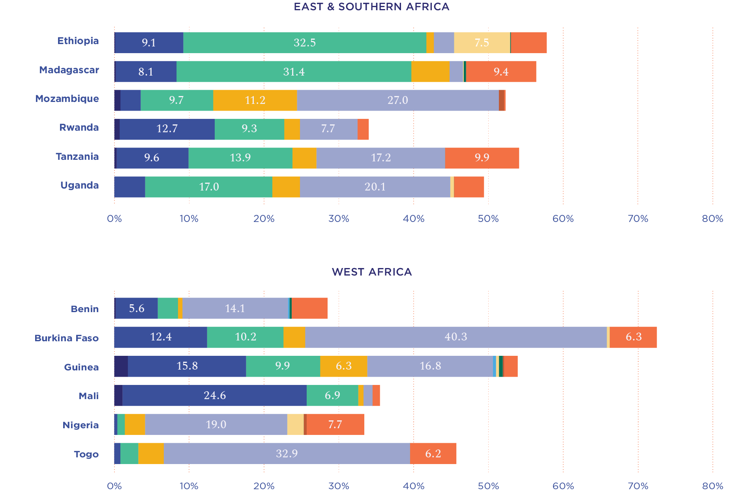
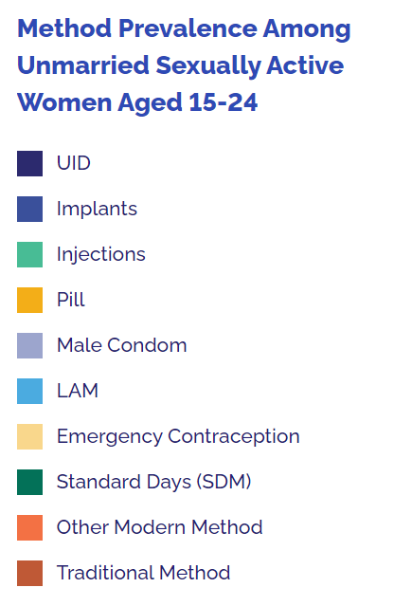

Slide 17
Postpartum Family Planning

Slide 18
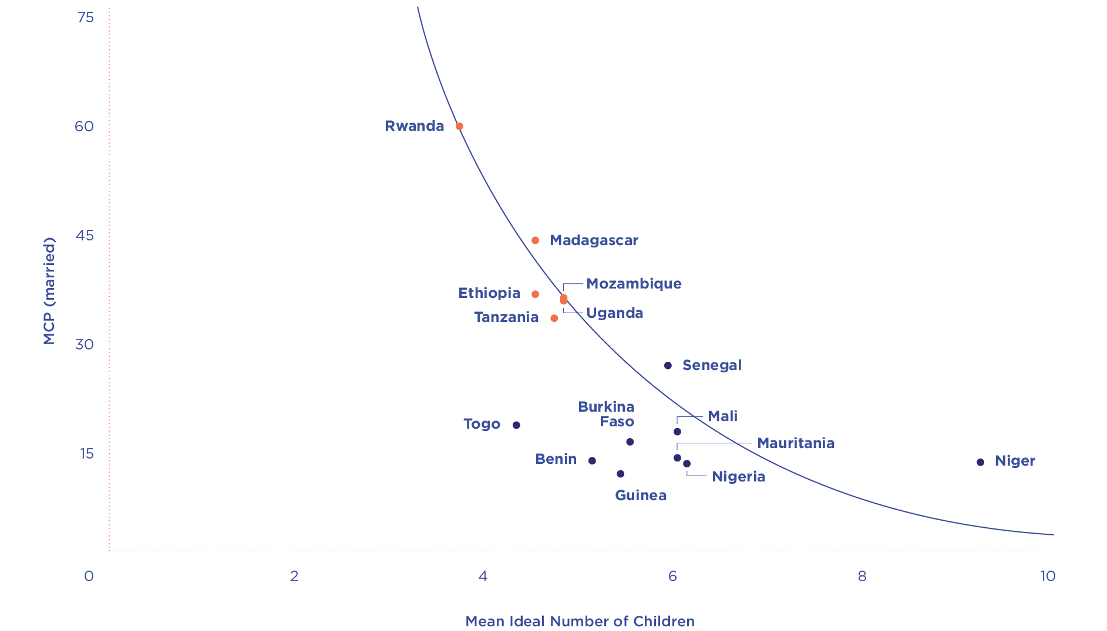
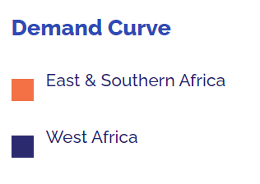

Slide 19
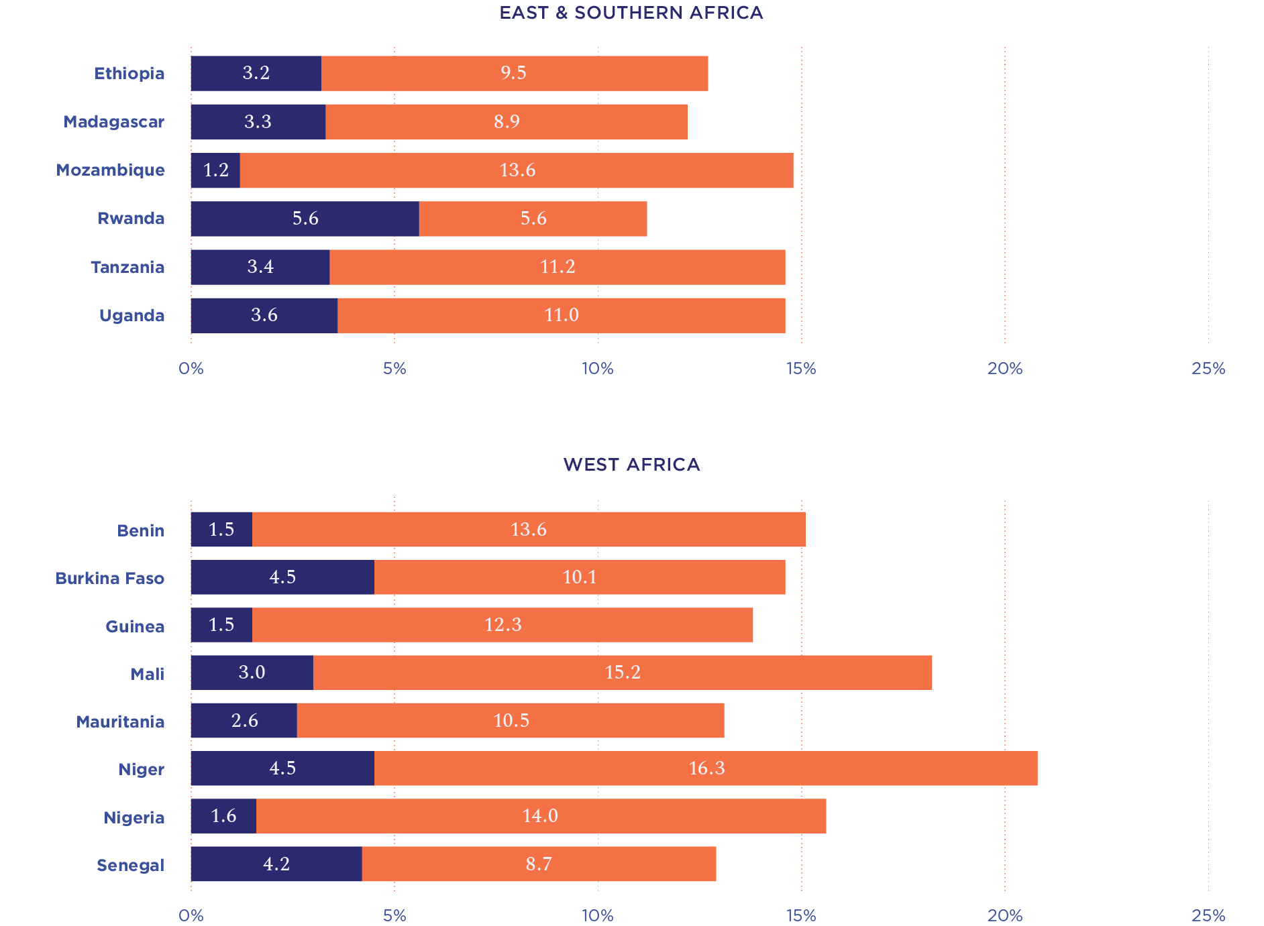
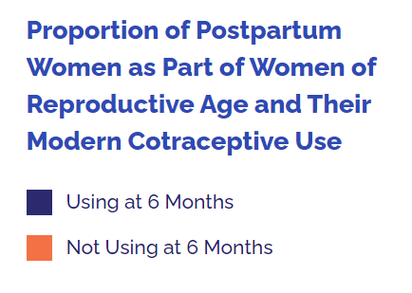

Slide 20
Finance

Slide 21
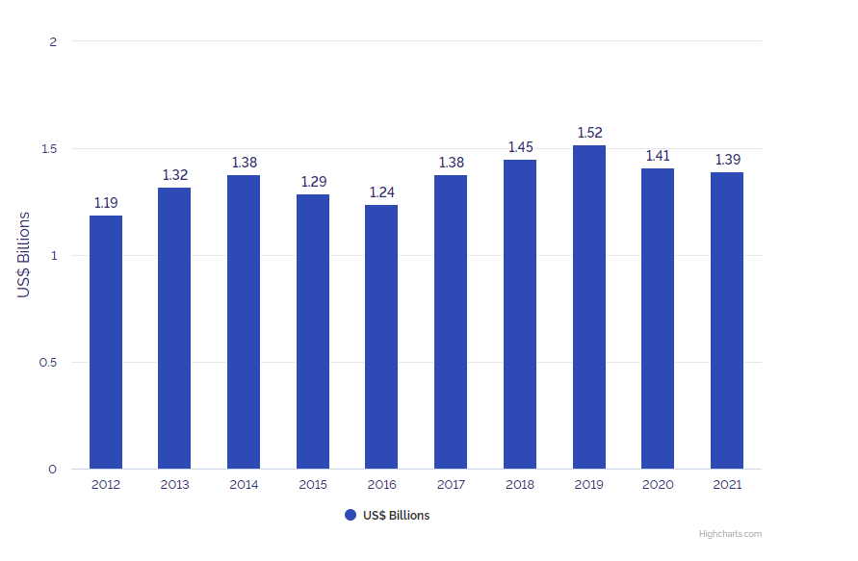

Slide 23
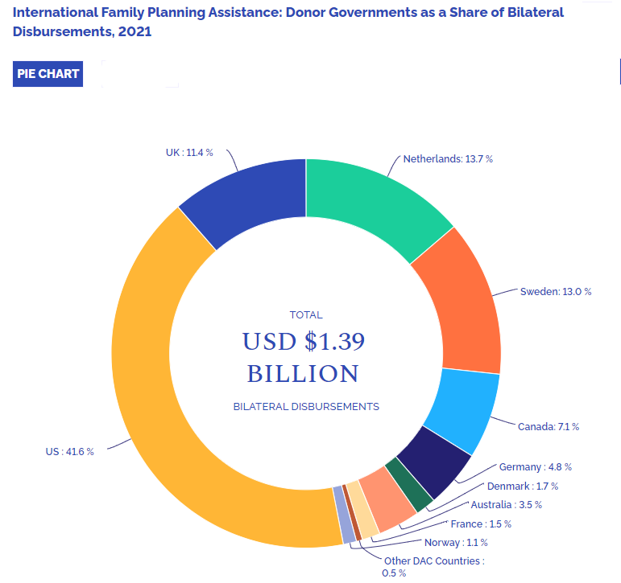

Slide 25
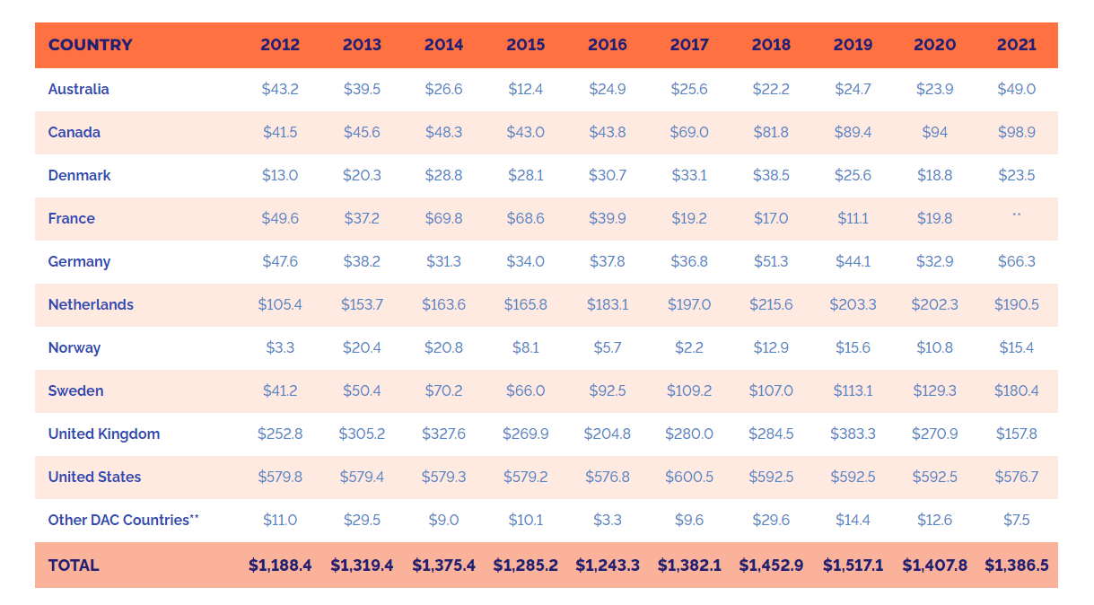

Slide 26
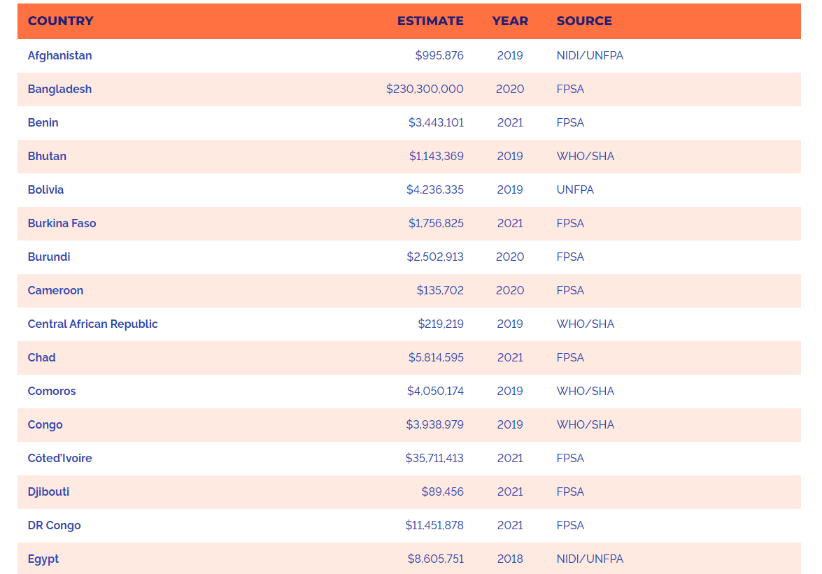

Slide 27
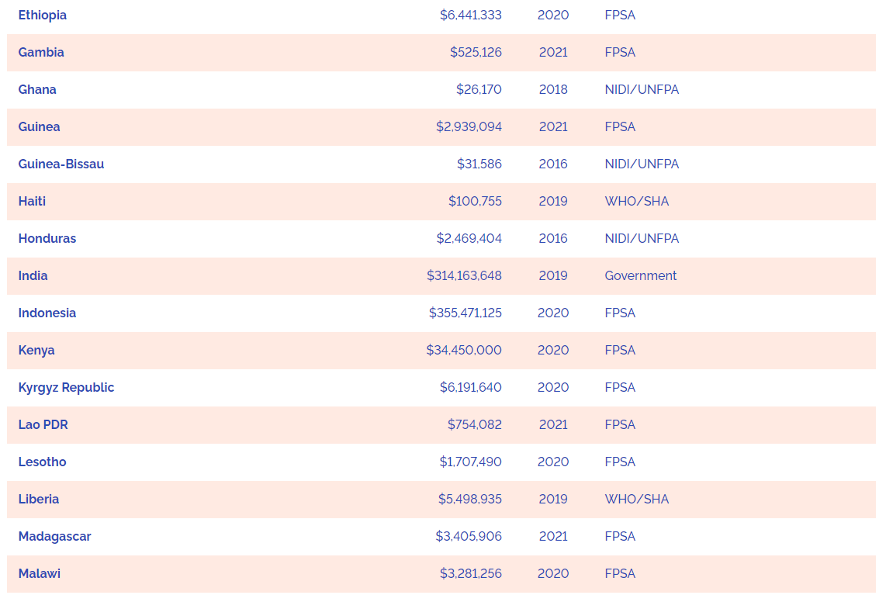

Slide 28
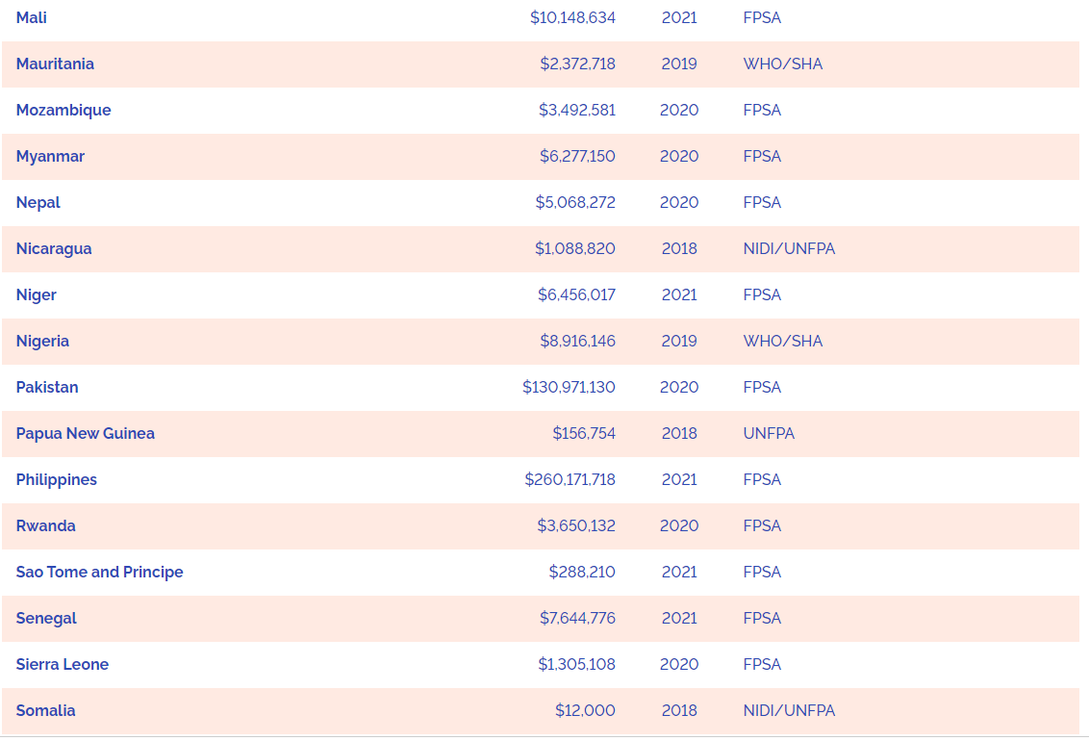

Slide 29
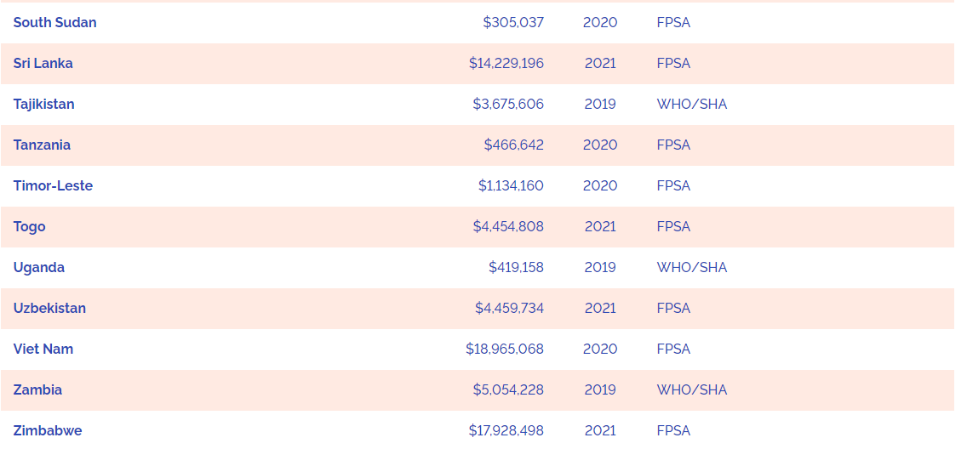

Slide 30
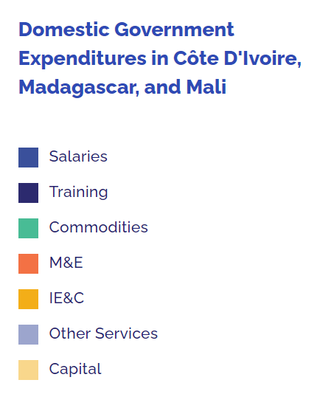

Slide 31
